Slide 1
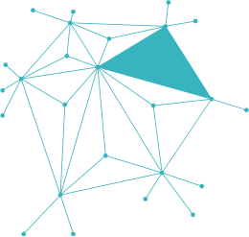

NETWORKING WORLD
COMPANY HAS TWO BRANCHES

Slide 2

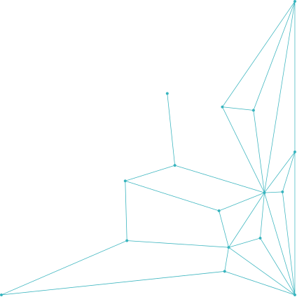
ABOUT US
This project presents a network design for a company that has two branches located in different cities. The main goal is to ensure secure and efficient communication between both sites using modern networking technologies. The design includes suitable network devices, a clear topology, and proper security measures to support daily business operations, data sharing, and centralized services.

Slide 3
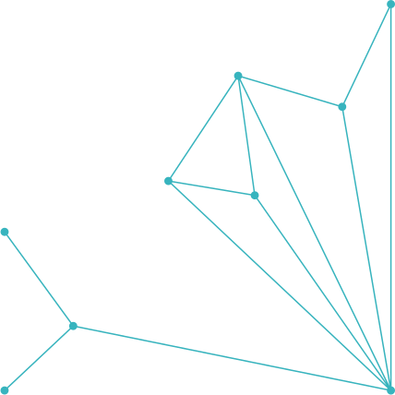
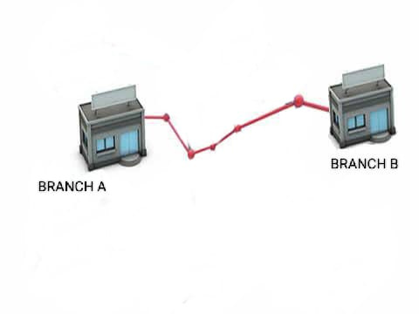
COMPANY BRANCHES OVERVIEW:-
Both branches require internet access, internal communication, and shared services such as file sharing and printing.

Slide 4
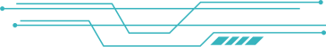

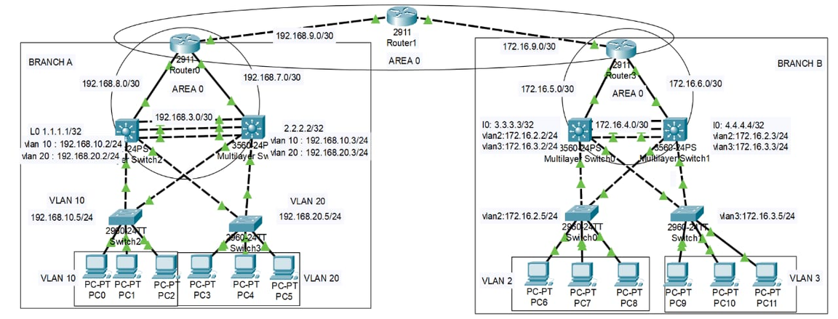
NETWORK TOPOLOGY:-
This diagram shows two branches connected through routers using OSPF.
Each branch has VLANs, multilayer switches for routing, and access switches for connecting PCs.
Trunk links and EtherChannel are used for redundancy and faster communication.

Slide 5


VLAN CONFIGURATION:-
VLANs are used to separate different departments within each branch for better security and traffic management.
Each VLAN has its own IP range to control network communication.
Branch A:
VLAN 10 → IP Range: 192.168.10.0/24
VLAN 20 → IP Range: 192.168.20.0/24
Branch B:
VLAN 2 → IP Range: 172.16.2.0/24
VLAN 3 → IP Range: 172.16.3.0/24

Slide 6

.
Branches are connected through routers using OSPF (Open Shortest Path First) inside AREA 0.
Each router is configured to advertise its VLAN subnets.
Secure communication between Branch A and Branch B is established over VPN tunnels.
Dynamic routing ensures high availability and fast recovery in case of link failure.
ROUTING AND INTER-BRANCH
COMMUNICATION:-

Slide 7

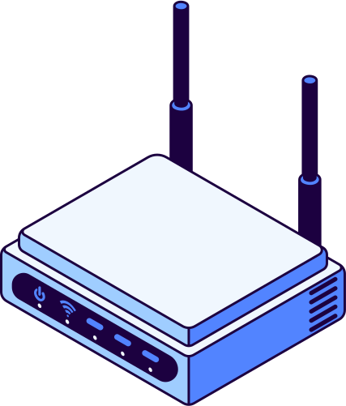
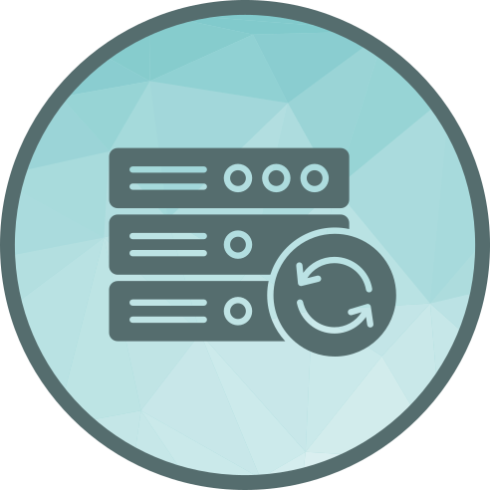
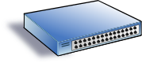








ESSENTIAL NETWORKING CONCEPTS AND SECURITY:-
Trunk
carries multiple VLANs over one link.
Router
Directs traffic between networks
Automatically gives IP addresses to devices.
DHCP
Switch
Connects internal devices
Separates the network into groups to
improve security and reduce traffic.
EtherChannel
VLAN
Combines multiple cables into one faster, more reliable link
PortFast
BPDU Guard
Makes ports active faster for end devices
Protects the network from rogue switches
Port Security
STP
Limits which devices can connect to a port
Prevents loops that can crash the network
OSPF
HSRP
Finds the best path for data quickly in big networks
Provides a backup gateway if the main router fails

Slide 8


Ahmed Samir Darwish
Saif Aleslam mohamed
Essam Elsayed Mahmoud
OUR AMAZING
TEAM:-
Ahmed Magdy Mustafa
Ahmed Ashraf
Abdel Aziz
Amer Mohamed Abdelhamed

Slide 9

